Slide 1

Project Title: Enhanced Lung Cancer Detection using Deep Learning and Vision Transformers. Domain: Healthcare and Medicine
Third Review
Course Code: CS7510
Course Title: Project 1
Register Number:24MSP3078
Name:Prassanna Laxmi
Date:13-12-2024

Slide 2
Abstract
One of the main causes of cancer-related deaths is lung cancer, and increasing survival rates requires early detection. The accuracy of current diagnostic techniques is challenged by small cancers and imaging variability to improve lung cancer detection by harnessing the capabilities of Vision Transformers (ViTs). ViTs are used to evaluate radiological scans like CT and X-ray pictures because of their tendency for accurately recording complex image components. To distinguish between benign and malignant instances with high accuracy, the suggested approach includes efficient pre-processing, reliable feature extraction, and an improved classification model. The ViT-based method performs better at capturing fine-grained details, which improves sensitivity and specificity whereas CNNs are used to extract local characteristics. The goals of this approach are to enhance patient outcomes, lower diagnostic mistakes, and help radiologists spot problems early.
Keywords: Convolutional Neural Networks(CNNs),Vision Transformers(ViTs), Lung Cancer Detection

Slide 3
Introduction
Lung cancer remains one of the leading causes of cancer-related mortality worldwide, emphasizing the urgent need for early detection and accurate diagnosis. Early identification significantly increases survival rates by enabling timely and effective interventions. However, existing diagnostic methods face critical challenges, particularly when dealing with small, early-stage tumors and the inherent variability in medical imaging. These limitations often result in diagnostic errors and delayed treatment, underscoring the necessity of innovative solutions in this domain.
Recent advances in deep learning have demonstrated remarkable potential in medical image analysis, with Convolutional Neural Networks (CNNs) emerging as a popular choice for feature extraction in radiological imaging. Despite their effectiveness in capturing local patterns, CNNs struggle with comprehensively understanding the global context of complex medical images, which is critical for distinguishing subtle differences between benign and malignant lesions. Vision Transformers (ViTs), on the other hand, have gained attention for their ability to capture global relationships and fine-grained details in images by leveraging self-attention mechanisms. This makes ViTs particularly suitable for analyzing radiological scans such as CT and X-ray images, where subtle image components play a pivotal role in accurate diagnosis.
In this research, a hybrid framework is proposed combining the strengths of CNNs and ViTs to address the challenges of lung cancer detection. The CNN component focuses on local feature extraction, identifying critical regions of interest, while the ViT component captures the global context and intricate details essential for accurate classification. This synergistic approach aims to enhance sensitivity and specificity in detecting lung cancer cases.
This study presents a hybrid framework CNNs for local feature extraction and ViTs for capturing global image context, aimed at improving lung cancer detection accuracy. With a novel classification model and a robust pre-processing pipeline, this approach seeks to enhance diagnostic reliability, reduce errors, and support radiologists in early detection efforts. The integration of CNNs and ViTs demonstrates the potential of hybrid deep learning architectures in addressing complex challenges in medical imaging and advancing diagnostic technologies.

Slide 4
Need of study
Lung cancer is a leading cause of cancer-related deaths, with survival rates reliant on early detection.
Current diagnostic methods face challenges in identifying early-stage tumors due to imaging variability and subtle characteristics.
CNNs excel in capturing local features but struggle with global image context.
ViTs offer a complementary approach by capturing fine-grained details and global relationships.
Integrating CNNs and ViTs can address gaps in sensitivity and specificity, enhancing diagnostic accuracy and supporting early detection.
This study aims to reduce diagnostic errors, support radiologists, and improve patient outcomes through advanced deep learning frameworks.

Slide 5
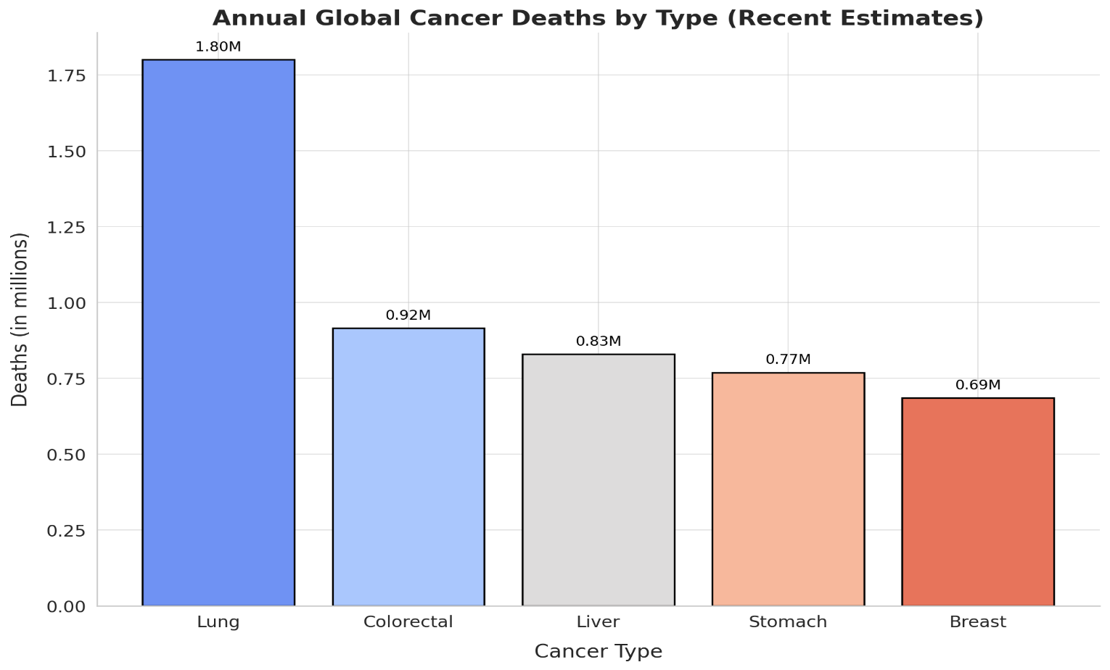
Problem Statement
To address the lung cancer related deaths challenges which require early detection to improve survival rates a hybrid framework Convolutional neural networks(CNNs) for local feature extraction and Vision Transformers (ViTs) for capturing global context, aiming to enhance diagnostic accuracy and support early detection is proposed.

Slide 6
Objectives
Define the focus of your study:
The focus of this study is to develop a hybrid deep learning framework CNNs and Vision Transformers (ViTs) to enhance the accuracy of early lung cancer detection by leveraging both local and global feature extraction.
Variables to be measured:
Input Variables (Features): Pixel intensity values from CT/X-ray scans and extracted features (local via CNNs and global via Vision Transformers).
Target Variable (Labels):
Class 0: Benign ( Mild Lung Tumour is present)
Class 1: Malignant case (Lung Cancer Present at uncontrollable stage)
Class 2:Normal cases(No cancer present)
Model Performance Metrics:
Accuracy
Precision
Recall
F1-Score\
Sensitivity and Specificity

Slide 7
Steps to be Involved:
Data Collection and Preprocessing:
Acquire and organize the dataset and Preprocess images (normalization, resizing, and intensity adjustments).
Data Augmentation:
Used to artificially expand the dataset by applying transformations to existing images , improving model generalization and robustness.
Data Splitting:
Split data into training and testing sets.
Model Development:
Design and implement CNN model
Design and implement ViT model
Design and implement a hybrid CNN-ViT model for classification.
Model Training:
Train the model on the preprocessed training data.

Slide 8
6.Model Evaluation:
Evaluate the model's performance using metrics like accuracy, sensitivity, specificity, and confusion matrix on test data.
7.Hyperparameter Tuning:
Optimize learning rates, batch size, and other parameters for improved performance.
8.Results Analysis:
Analyze performance results to ensure accurate classification.
9.Deployment/Conclusion:
Summarize findings and prepare the model for practical use or further research.

Slide 9
Limitation of the study:
Dataset Size: Limited labeled data may affect the model's generalizability.
Imaging Variability: Variations in scan quality and patient demographics can impact performance.
Class Imbalance: Unequal class distribution may introduce bias in model training and accuracy.
For Performing: GPU is required to run more than 50 epochs.

Slide 10
Related Work
S.NO | Title of the paper | Authors | Journal/Conference Title and Publisher | Year of Publication | Methodology used | Performance of the proposed algorithm | Limitations of the research | Future approach
1. | Deep Learning Techniques to Diagnose Lung Cancer | Lulu Wang | MDPI, Cancers | 2022 | Compare technique like CNN, Faster R-CNN, Mask R-CNN, and U-Net | Comparision between the different algorithms in different papers | ----- | develop new convolutional networks and loss functions to improve the performance bring prior clinical knowledge into model training single disease identification to complete disease identification

Slide 11
S.NO | Title of the paper | Authors | Journal/Conf erence Title and Publisher | Year of Publication | Methodology used | Performance of the proposed algorithm | Limitations of the research | Future approach
2. | Enhancing lung cancer diagnosis with data fusion and mobile edge computing using DenseNet and CNN | Chengping Zhang, Muhammad Aamir, Yurong Guan, Muna Al-Razgan, Emad Mahrous Awwad, Rizwan Ullah, Uzair Aslam Bhatti, Yazeed Yasin Ghadi | Science Direct, ELSEVIER | 2024 | DenseNet, CNN, Data Fusion, Mobile Edge Computing | Accuracy-99% Precision-99% Recall-99% F1-99% | ----- | Risk mitigation Clinical implementation Comprehensive validation
3. | A novel hybrid deep learning method for early detection of lung cancer using neural networks | Shalini Wankhad, Vigneshwari S. | Science Direct, ELSEVIER | 2023 | Deep leaning technique - 3D-CNN | Accuracy-95% Sensitivity-87% Selectivity-90% | ----- | -----
4. | Enhancing lung abnormalities detection and classification using a Deep Convolutional Neural Network and GRU with explainable AI: A promising approach for accurate diagnosis | Md Khairul Islam, Md Mahbubur Rahman, Md Shahin Ali, S.M. Mahim, Md Sipon Miah | Science Direct, ELSEVIER | 2023 | Deep CNN, GRU, Explainable AI | Accuracy98.79% Recall-99% Precision-99% Specifity-99% | ----- | Risk Mitigation Improvement of Patient Outcomes Integration of Robust Security Measures

Slide 12
S.NO | Title of the paper | Authors | Journal/Conf erence Title and Publisher | Year of Publication | Methodology used | Performance of the proposed algorithm | Limitations of the research | Future approach
5. | Detection and classification of lung cancer using CNN and Google Net | R. Pandian, V. Vedanarayanan, D.N.S. Ravi Kumar, R. Rajakumar | Science Direct, ELSEVIER | 2022 | CNN, GoogleNet, VGG-16 | Accuracy-98% F1-Score-98% Specificity-99% | ----- | -----

Slide 13
Proposed Methodology

Slide 14
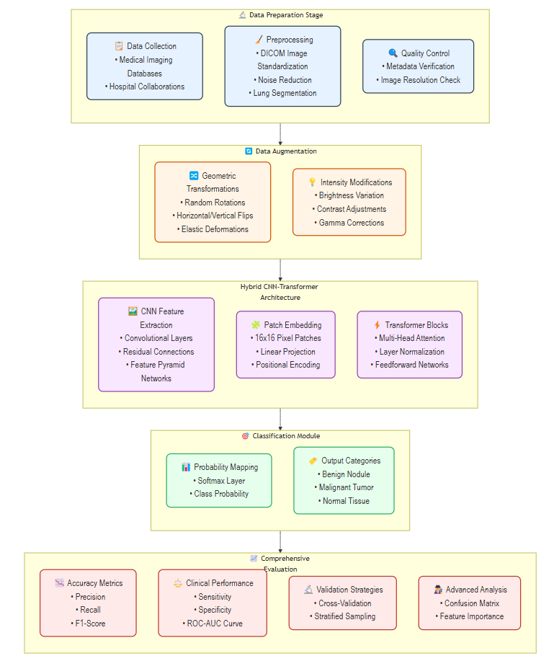
Architecture Diagram:

Slide 15
1. Data Preparation Stage
Data Collection: Use medical imaging datasets, such as DICOM files, CT scans sourced from hospital collaborations and publicly available databases.
Preprocessing:
Noise Reduction: Apply denoising algorithms to remove artifacts.
Lung Segmentation: Use automated segmentation tools to isolate regions of interest.
Quality Control:
Metadata Verification: Validate dataset integrity.
Image Resolution Check: Ensure images meet the required resolution standards.
2. Data Augmentation
Geometric Transformations:
Random rotations, horizontal/vertical flips, and elastic deformations to enhance diversity.
Intensity Modifications:
Brightness variations, contrast adjustments, and gamma corrections to improve robustness.
3. Hybrid CNN-Transformer Architecture
CNN Feature Extraction:
Convolutional layers with residual connections to capture spatial patterns.
Transformer Blocks:
Split images into patches (e.g., 16x16).
Perform linear projection and add positional encodings.
Incorporate multi-head attention, layer normalization, and feedforward layers for global context modeling.

Slide 16
4. Classification Module
Probability Mapping:
Use a softmax layer to generate class probabilities.
Output Categories:
Classify images into benign nodules, malignant tumors, or normal tissue.
5. Comprehensive Evaluation
Accuracy Metrics:
Measure precision, recall, and F1-score for classification performance.
Clinical Performance:
Compute sensitivity, specificity, and ROC-AUC for medical relevance.
Validation Strategies:
Apply cross-validation and stratified sampling to ensure robustness.
Advanced Analysis:
Use a confusion matrix and feature importance evaluations to analyze results.

Slide 17
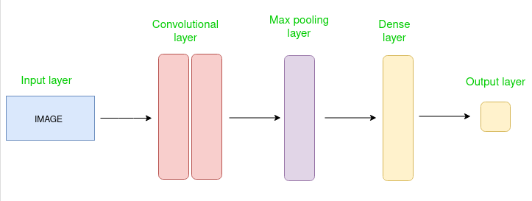
CNN Architecture:

Slide 18
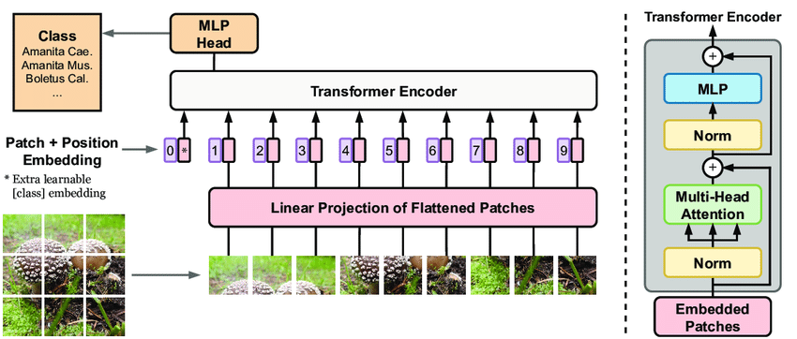
Vision Transformers:

Slide 19
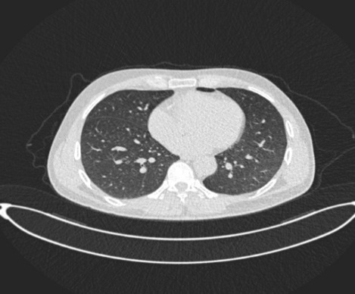
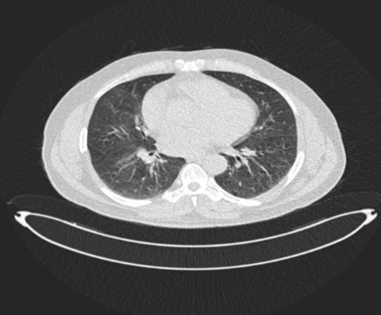
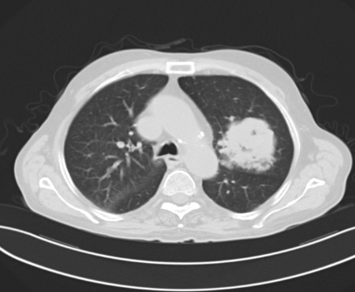
Dataset
Source of the Dataset:
https://www.kaggle.com/datasets/adityamahimkar/iqothnccd-lung-cancer-dataset?resource=download
No. of Observations:1190 images represents 110 cases
Normal: 55 cases(fig 1)
Benign: 15 cases(fig 2)
Malignant: 40 cases(fig 3)
Details about the images – my images are in .jpg format
Normal case
Benign case
Malignant case

Slide 20
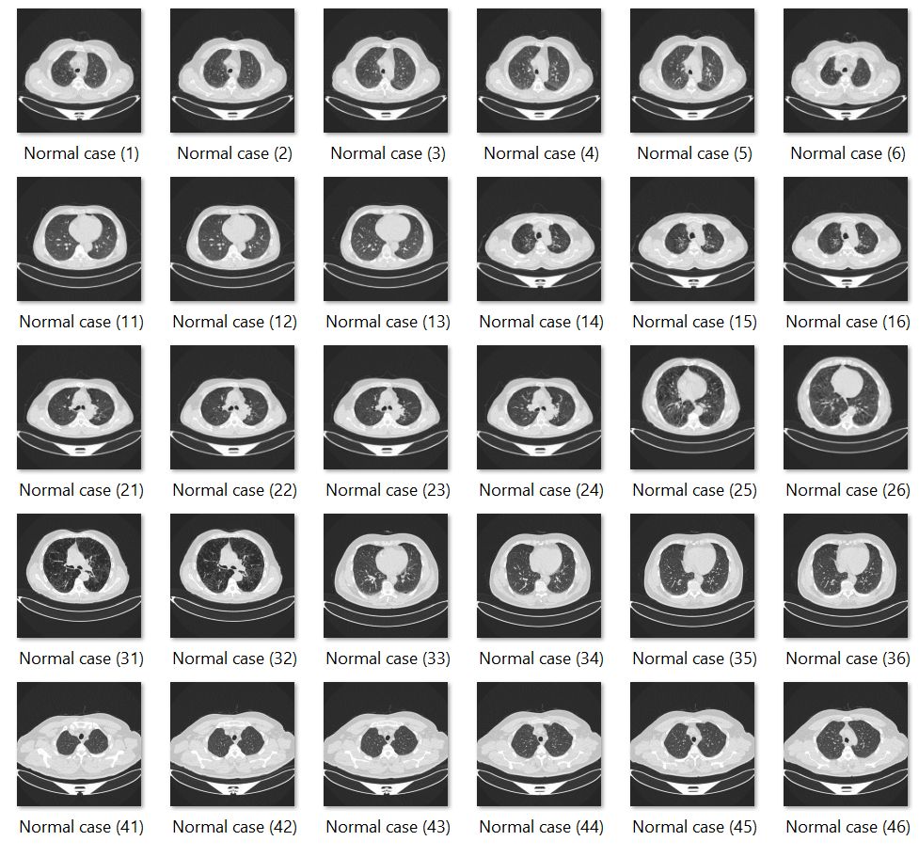
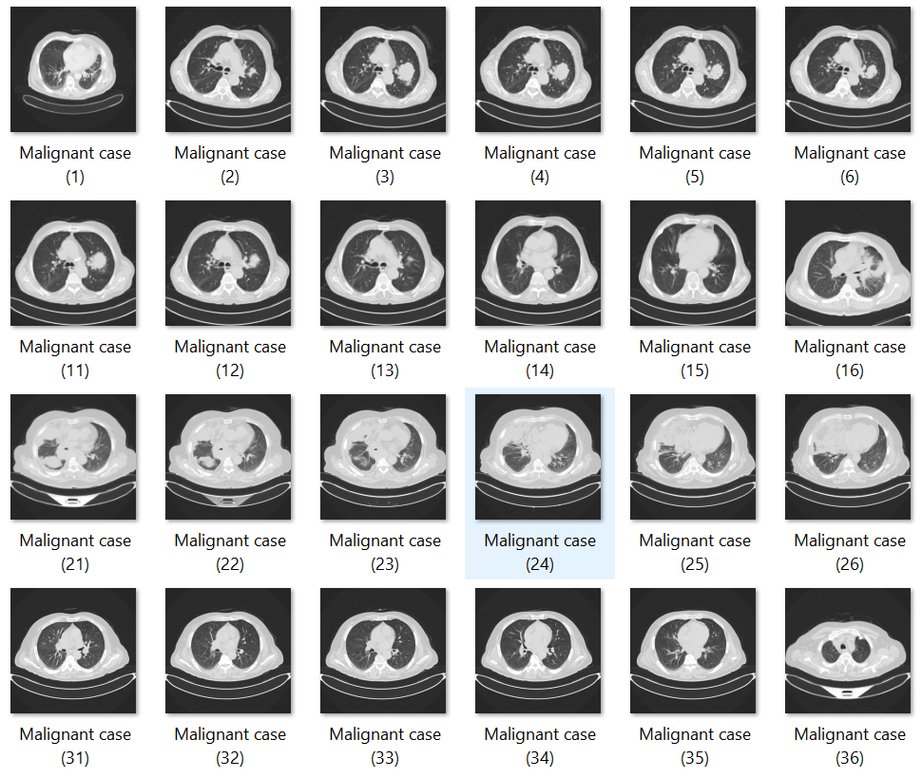
Screenshot of the Dataset:

Slide 21
Exploratory Data Analysis

Slide 22
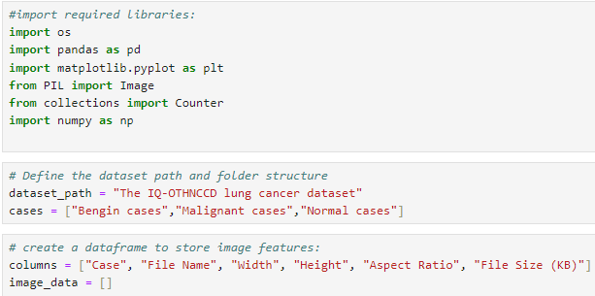
Step-1: Install and Import required libraries

Slide 23
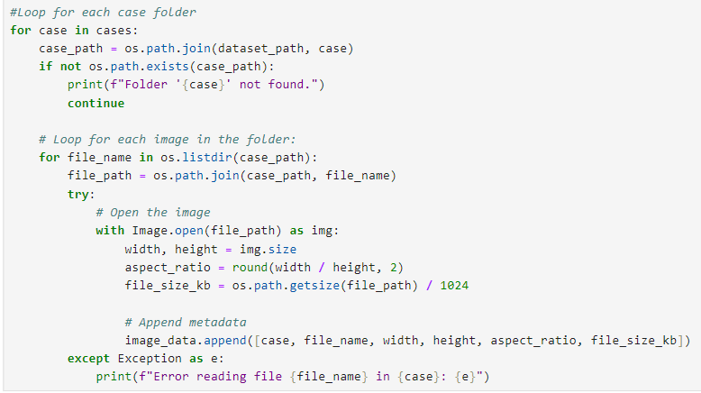
Interpretation:
Code for getting all the images in all the folder and convert them into the dataframe .

Slide 24
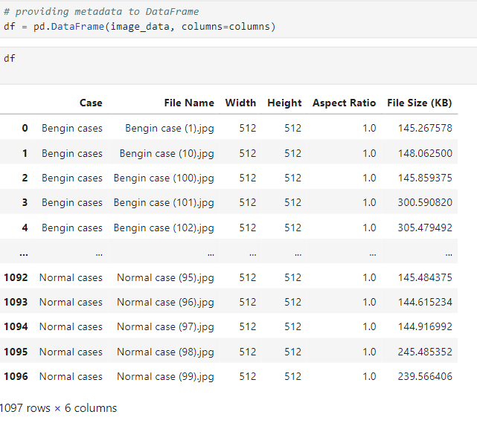
Interpretation: The data is converted into data frame which has columns: 1.Type of case 2.File Name 3.Width of the image 4.Height of the image 5.Ascept Ratio 6.File Size

Slide 25
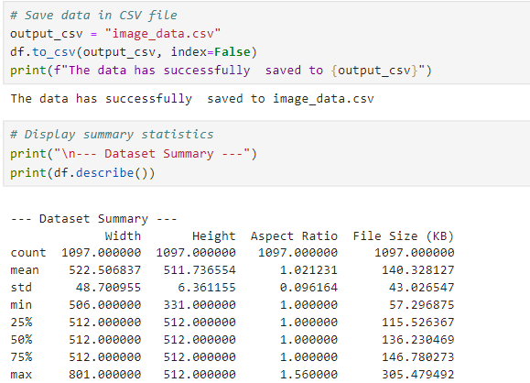
Interpretation: After the data is stored in df the the dataframe is stored in csv file for further usage. For that image_data the statistical information is calculated : mean of weight:522.50 mean of height:511.736

Slide 26
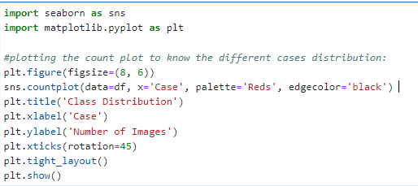
Plotting Count Plot for knowing the distribution of different cases:

Slide 27
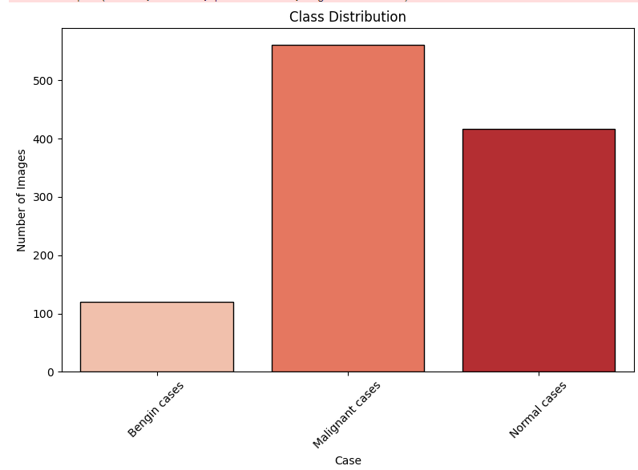
Output:
Interpretation:
Bengin cases has least number images : 120 images
Malignant cases has highest number of images:561 images
Normal cases has average images of total:416 images

Slide 28
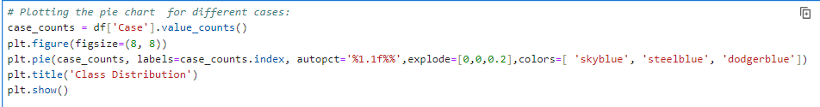
Plotting pie chart for knowing the distribution of different cases:

Slide 29
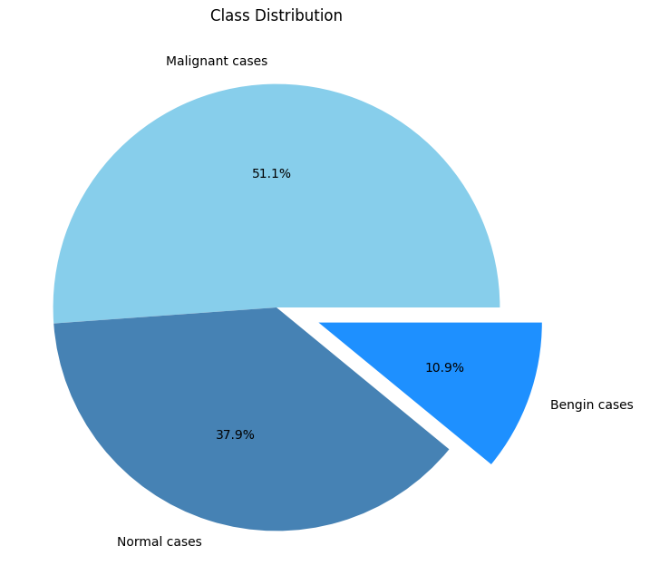
Output:
Interpretation:
The malignant cases from the lagest proportion of the dataset of 51.1% .
Smallest group of 10.9% data is of bengin cases.
Second largest group of 37.9% data is of normal cases.
We can see that there is a clear class imbalance in dataset , with malignant cases being the majority and ither cases has small portions.
Clinical Relevance: The focus on malignant cases ( over 50 % ) aligns with the critical importance of detecting malignancies in medical diagnostics.

Slide 30
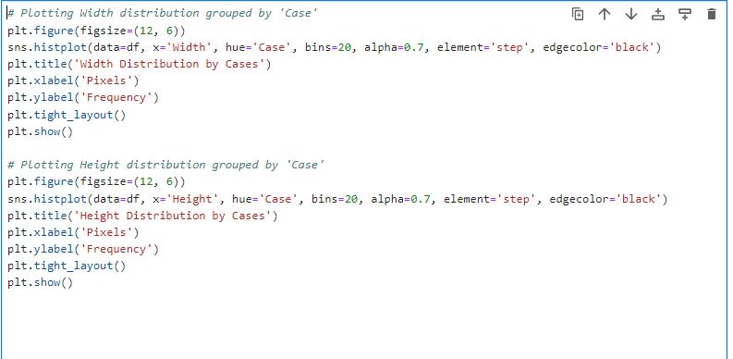
Plotting the histogram for knowing the width distribution is among different cases

Slide 31
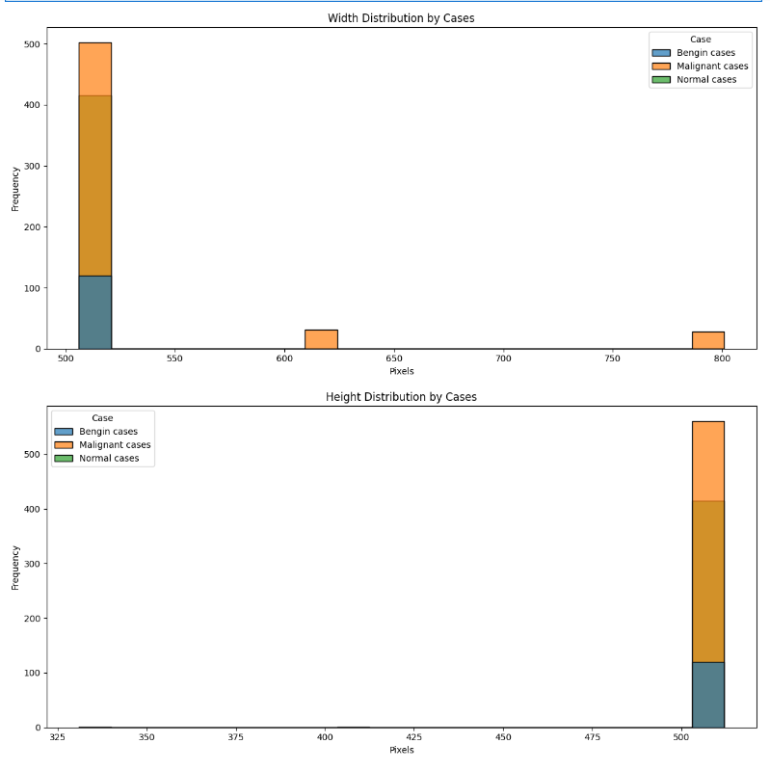
Interpretation:
Major Range- most of all the cases have a width and height around 512 pixels.
Rare Sizes(Width): Some cases have widths around 600 pixels and few outliers present at 800 pixels.
Rare Sizes(Height): Some cases have heights between 325 pixels and 400 pixels.
Nomal cases : for both height and width all the images ranges at 512 pixels.
Malignant cases and Benign Cases : for both width and height images are scatter most at 512 pixels few at 620 pixels and few at 790 pixels.

Slide 32
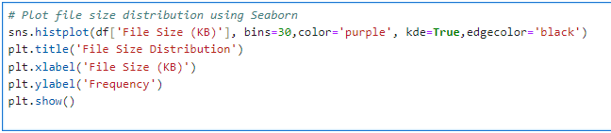
Plotting the histogram for file size distribution

Slide 33
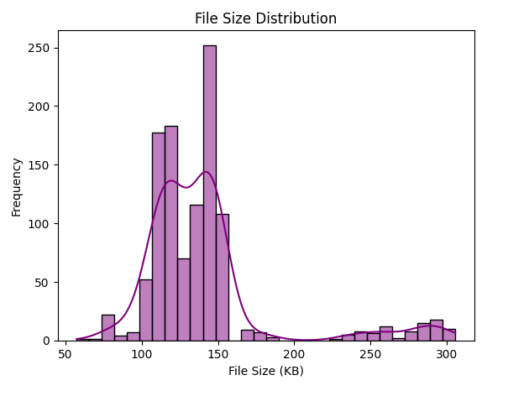
Output:
Interpretation:
File size range – 50 KB TO 300 KB
Peak frequency: 100 KB TO 150 KB peak around 150 KB , gradual decline toward larger file sizes.
Skewness: the distribution is right skewed

Slide 34
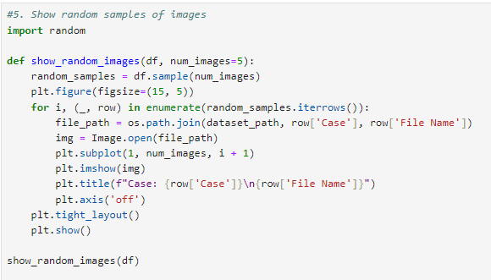
To show few sample images of my dataset of different cases:

Slide 35
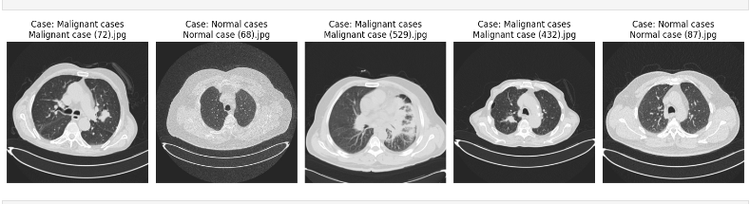
Output:

Slide 36
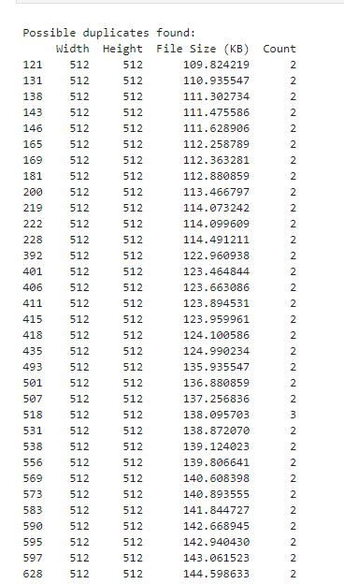
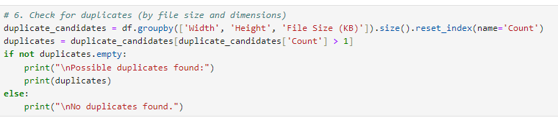
Finding any duplicates found:
Interpretation:
These duplicates are determined based on matching image dimensions (width and height) and file size, suggesting they are identical or nearly identical copies.

Slide 37
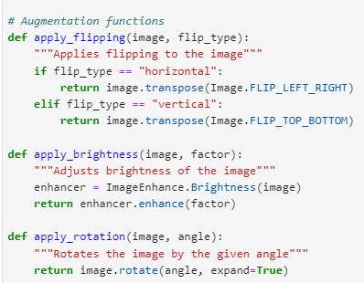
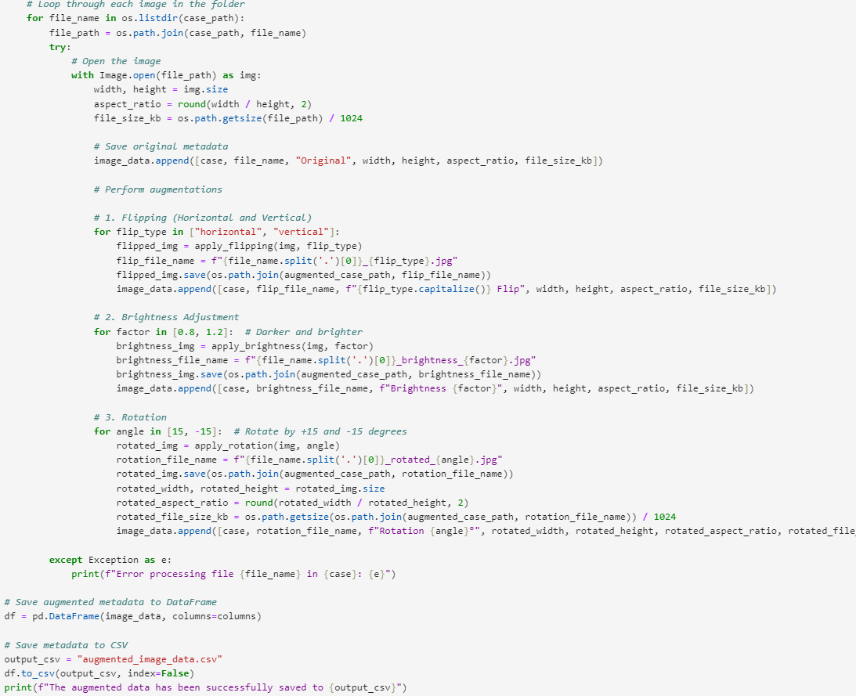
Data Augmentation:

Slide 38
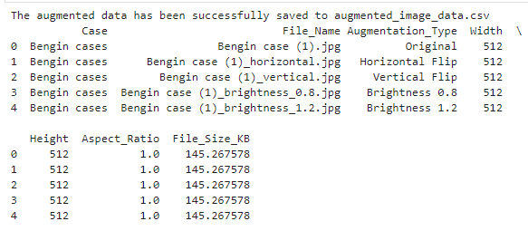
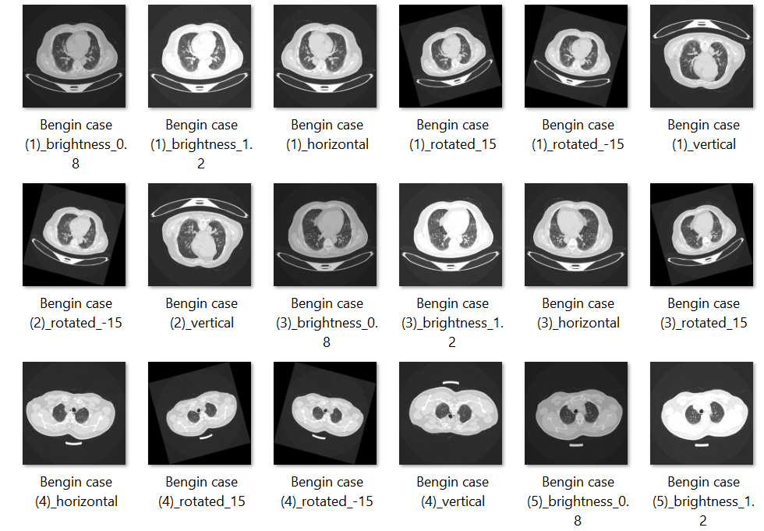
Output:

Slide 39
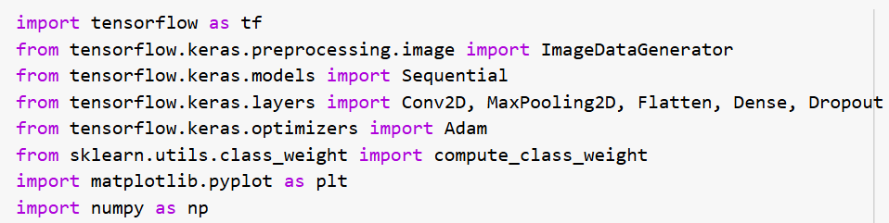
Distributing weights to the different cases:
Importing Necessary Libraries:

Slide 40
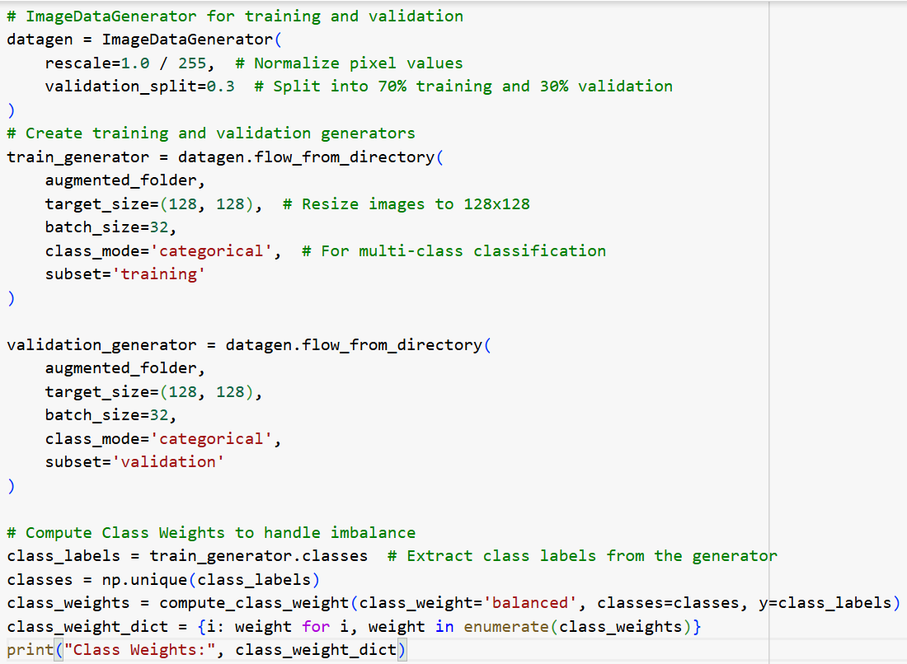

Slide 41
Output:
Interpretation:
For training dataset : 4609 images
For testing dataset: 1973 images
Ratio: 70 : 30

Slide 42
Results and Discussion – CNN Model

Slide 43
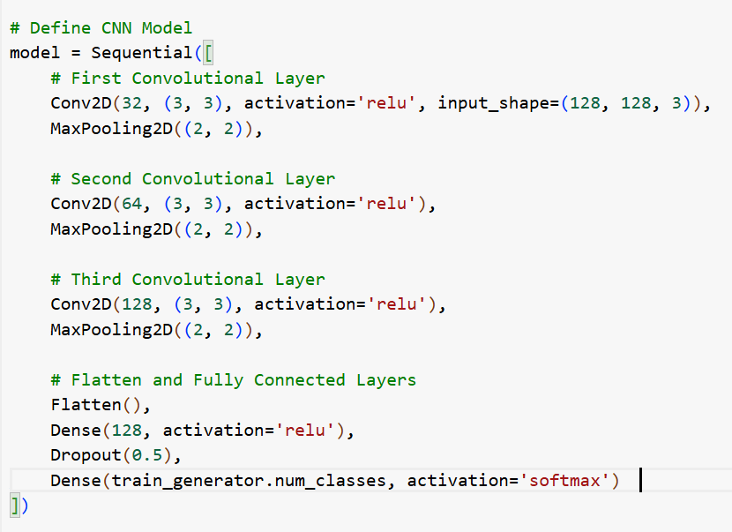
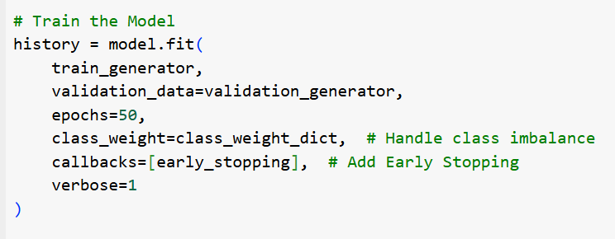

Slide 44
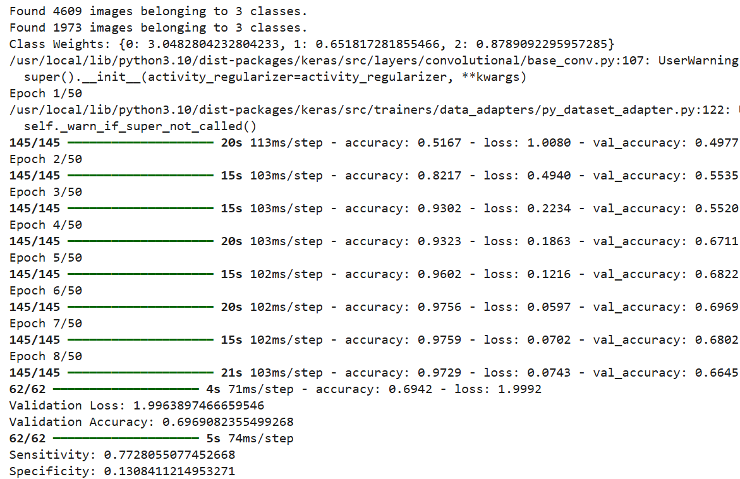
Output:
Interpretation:
Dataset Distribution:
Training: 4609 images across 3 classes.
Validation: 1973 images across 3 classes.
Class Weights:
Class 0: 3.0482
Class 1: 0.6518
Class 2: 0.8789
ModelTraining:
Epochs1-50:Gradual improvement in training accuracy, reaching a high of 97.5%.Validation accuracy fluctuates, peaking around 70%.
Training loss decreases steadily, suggesting the model is learning, but the validation loss fluctuates.
Validation Metrics:
Final validation loss: 1.9963
Validation accuracy: 69.69%
Sensitivity: 77.28% (ability to correctly identify positive cases)

Slide 45
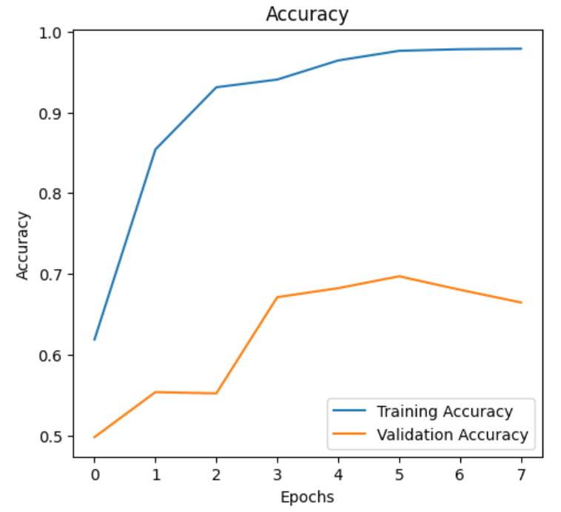
Evaluation:
Interpretation:
Training Accuracy: The training accuracy increases rapidly during the initial epochs and plateaus near 1.0 by epoch 4.This indicates that the model is learning the training data well.
Validation Accuracy: Validation accuracy improves up to epoch 4, after which it slightly declines.

Slide 46
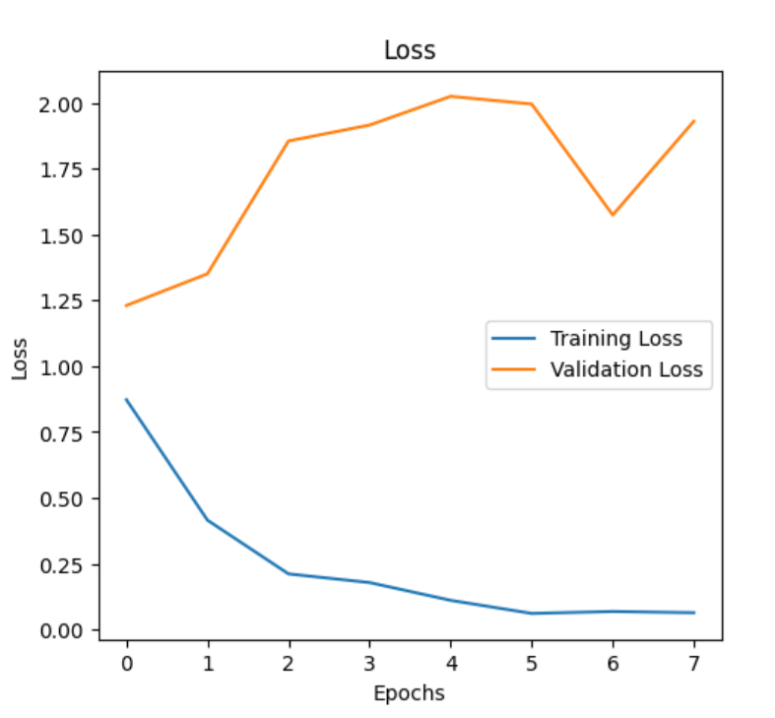
Interpretation:
Training Loss:The blue curve represents the training loss.It steadily decreases as the number of epochs increases, indicating that the model is learning effectively from the training data.
Validation Loss:The orange curve represents the validation loss.Initially, the validation loss decreases slightly, suggesting the model starts to generalize to unseen data.

Slide 47
Results and Discussion –Vision Transformers Model

Slide 48
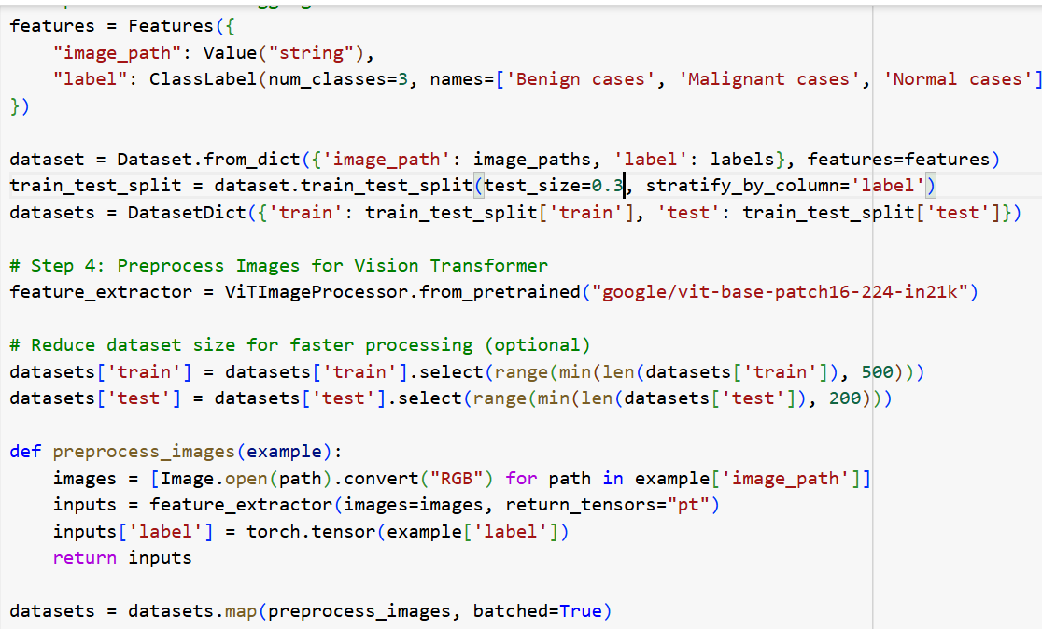
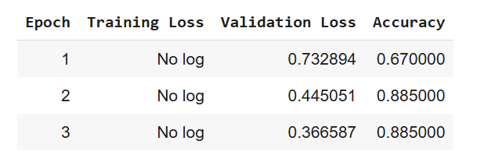
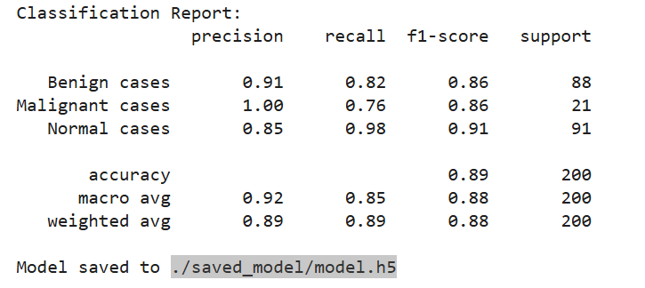
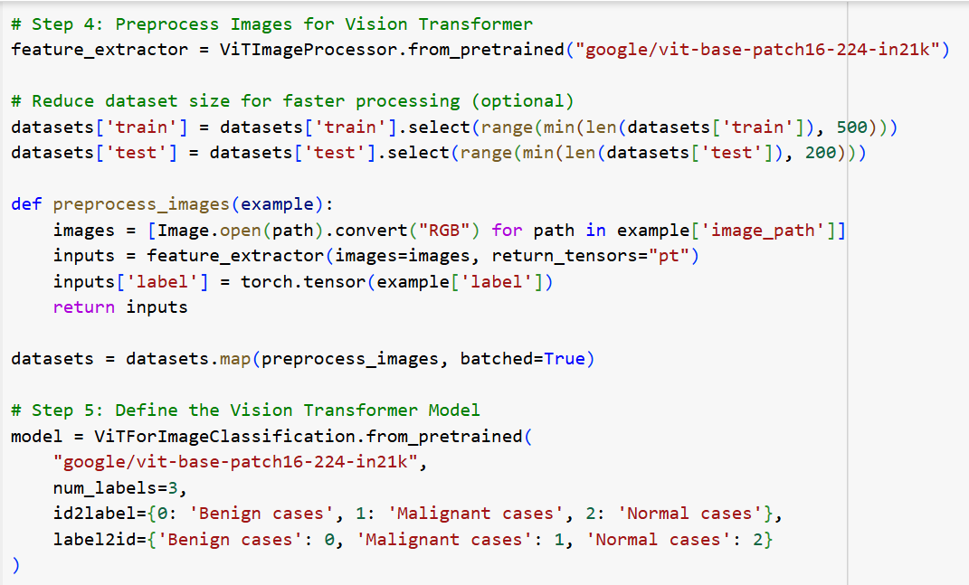
Output:

Slide 49
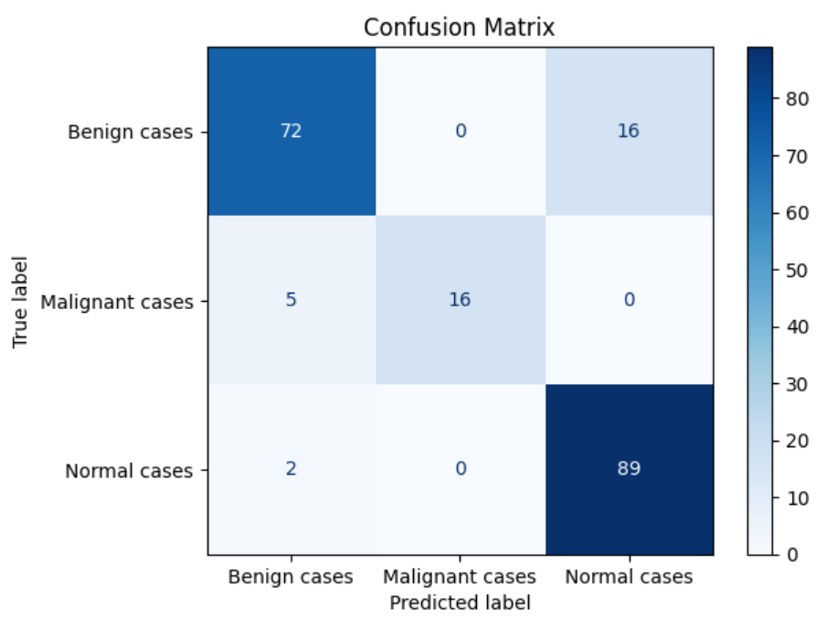
Confusion Matrix:

Slide 50
Performance Analysis
Model | Accuracy | Loss | Sensitivity | Specificity
Deep hierarchical semantic CNN (HSCNN)(Base Paper) |  |  | 70.5%
CNN model | 69.69% | 1.9963 | 72.28
Vision Transformers (Proposed system) | 89% | -- | --- | ---
Vision Transformers--- Classes | Precision | Recall | F1-score
Benign cases | 91% | 82% | 86%
Malignant cases | 100% | 76% | 86%
Normal cases | 85% | 98% | 91%
Interpretation:
Accuaracy increases continuously with the increase of number of epoches

Slide 51
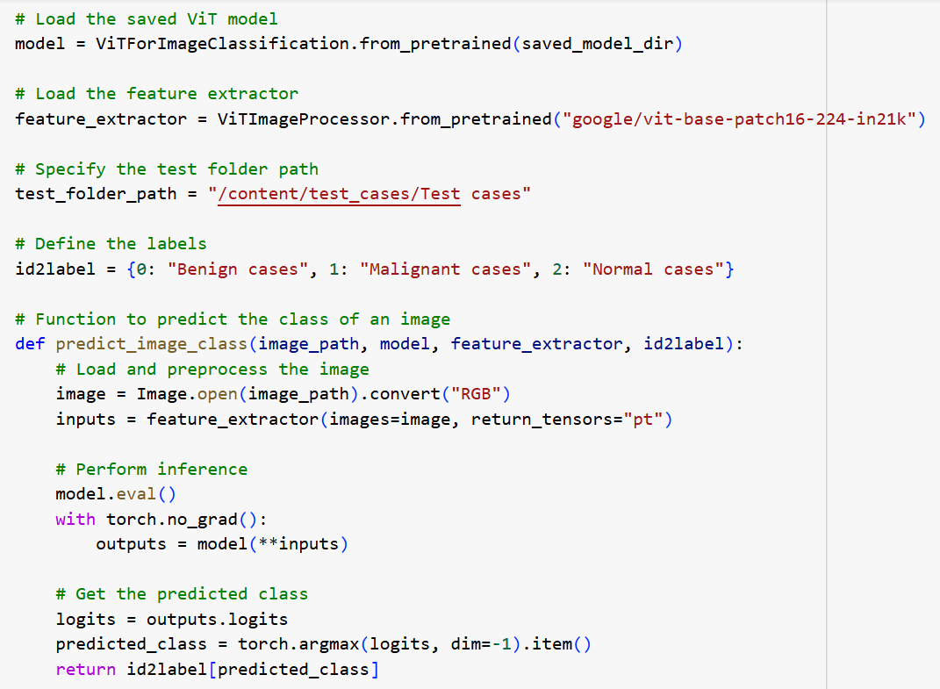
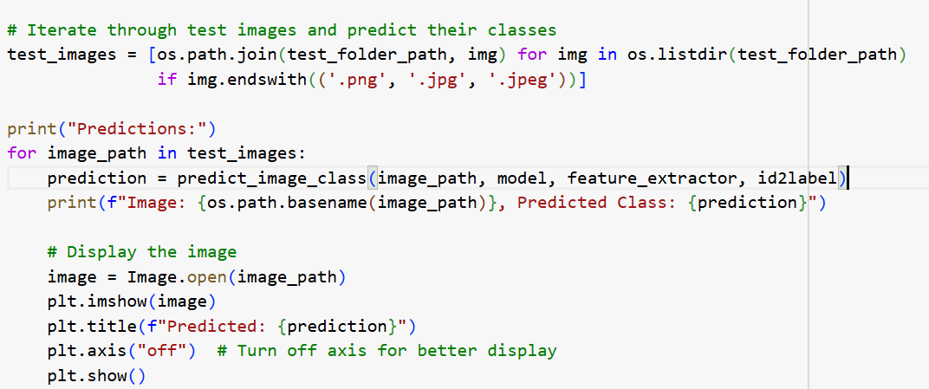
Predictions:

Slide 52
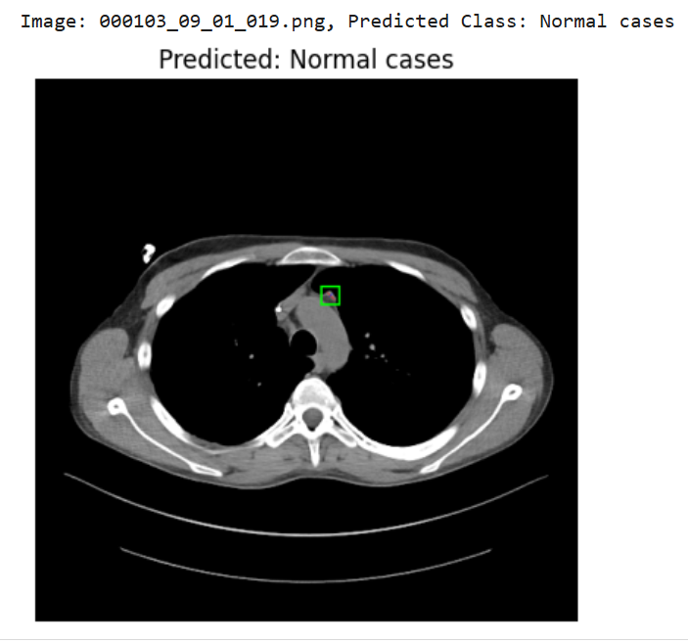
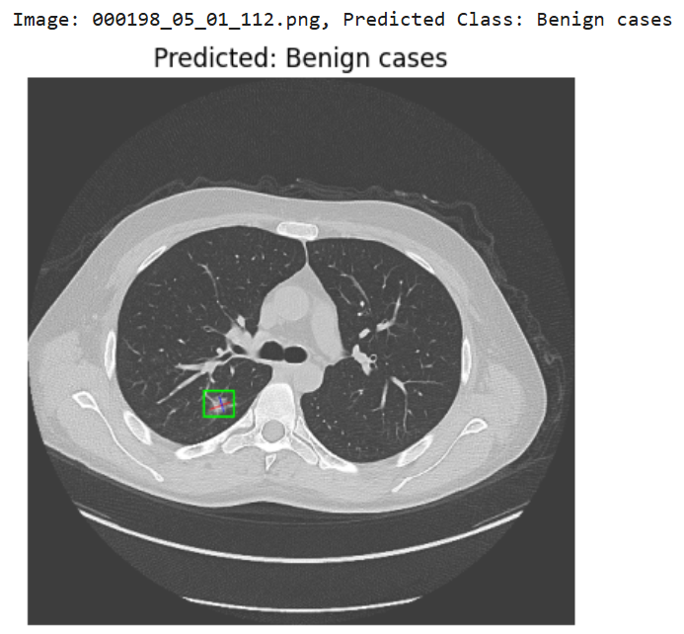
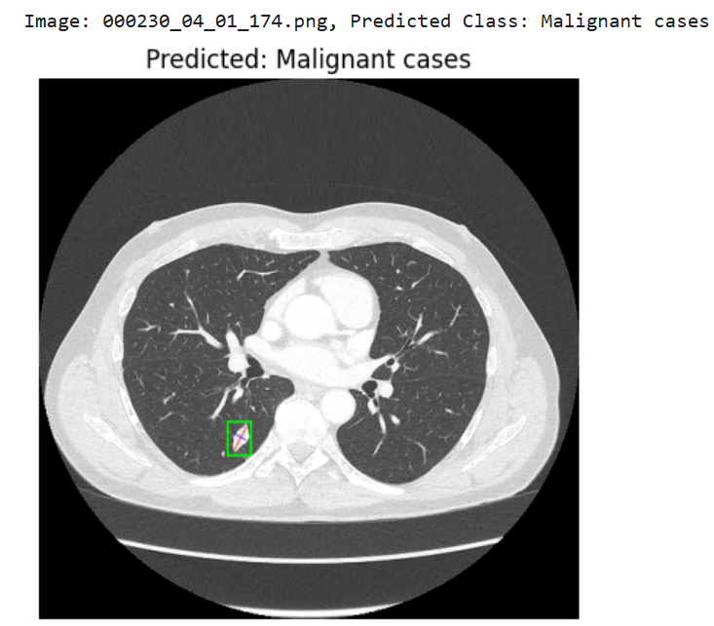
Output:

Slide 53
Conclusion
Improved Model Performance.
As we use Vision Transformers - Enhanced Feature Representation.
Explainable Results.
This outcome will provide not only a high-performing model but also meaningful contributions to the medical and research communities by improving the reliability and applicability of AI-based lung cancer diagnostics.

Slide 54
Future Enhancement
Optimization for Real-World Deployment:
Compress models for faster inference and use in low-power devices.
Integrate with hospital systems for real-time diagnostic feedback.
Self-Supervised Learning:
Leverage large unlabeled medical datasets to pretrain the model, reducing reliance on labeled data.
Clinical Trial Validation:
Test the approach across multiple clinical settings to ensure reliability and robustness.
Personalized Risk Profiling:
Combine model outputs with patient demographics and lifestyle factors for individualized cancer risk assessment.
Continuous Learning:
Develop a framework to update the model with new imaging data while retaining prior knowledge.

Slide 55
References
[1] Md Khairul Islam , Md Mahbubur Rahman , Md Shahin Ali , S.M. Mahim , Md Sipon Miah , “Enhancing lung abnormalities detection and classification using a Deep Convolutional Neural Network and GRU with explainable AI: A promising approach for accurate diagnosis “, 2023
[2] R. Pandian, V. Vedanarayanan, D.N.S. Ravi Kumar, R. Rajakumar, “Detection and classification of lung cancer using CNN and Google net” , 2022
[3] Shalini Wankhade, Vigneshwari S., “A novel hybrid deep learning method for early detection of lung cancer using neural networks”, 2023
[4] Chengping Zhang , Muhammad Aamir, Yurong Guan,Muna Al-Razgan,Emad Mahrous Awwad , Rizwan Ullah , Uzair Aslam Bhatti , Yazeed Yasin Ghadi, “Enhancing lung cancer diagnosis with data fusion and mobile edge computing using DenseNet and CNN” , 2024

